Slide 1
what is PLT?
Sept 2025

Slide 2
and how to use
PLT successfully

Slide 3
Personal Learning Time is self directed time for you to learn with teacher support

Slide 4
you have CHOICE and OWNERSHIP over your learning

Slide 5
skills you’ll develop:
questioning, communication, goal setting, organization, time management, self regulation & self awareness

Slide 6
You are acquiring the skills necessary to use unstructured time in a way that benefits your learning

Slide 7
guiding questions to prep for plt
What do you need to be successful in your classes?
How is your mental health or personal wellness?
Who can you seek out for guidance or help?

Slide 8
guiding questions to prep for plt
What do you need help with?
What do you not understand?
What do you wonder?
How can you deepen your understanding?
How can you help someone else?

Slide 9
what can you do during PLT?
Get help from teachers or peers
Homework / assignments / projects
Prepare for upcoming tests / quizzes
Request to catch up on missed tests / quizzes / assignments

Slide 10
what can you do during PLT?
Organize your notes / binder
Self-directed learning
Practice or fine-tune skills
Engaged reading / journaling / reflecting
Manage personal wellness

Slide 11
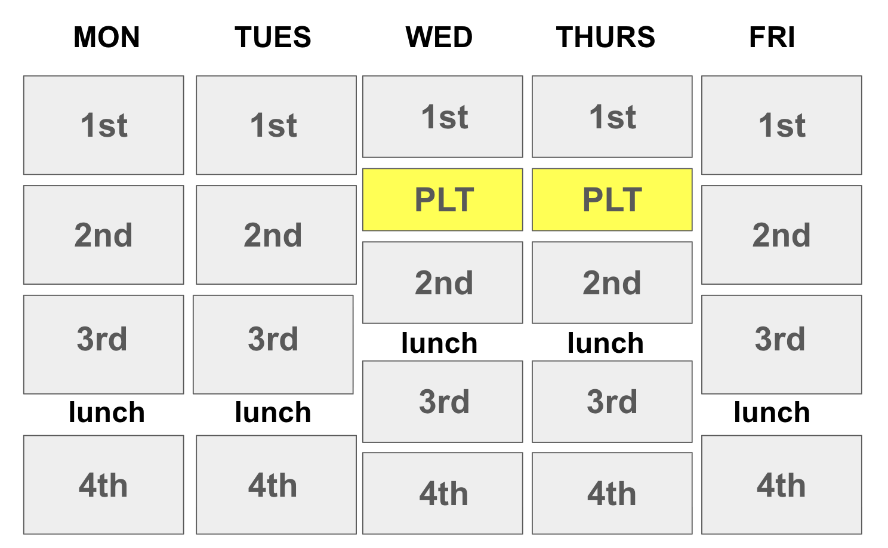
9:43 – 10:31 am
Notes:
We need a resilience toolbox.

Slide 12

Grades 8 & 9 | Sign up with one of your 8 teachers
Grades 10, 11 & 12 | Sign up for any space
Notes:
We need a resilience toolbox.

Slide 13
Students are expected to be in a learning space, working independently or collaboratively to pursue their educational goals
Notes:
We need a resilience toolbox.

Slide 14
Attendance will be taken in all learning spaces
Notes:
We need a resilience toolbox.

Slide 15
Planning
Your Personal Learning Time

Slide 16
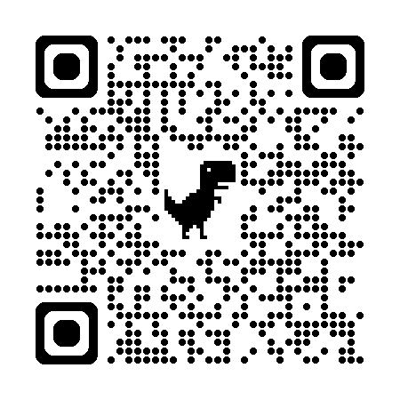
sign up!
1
https://bcsd38.sharepoint.com/sites/richmondsecondaryplt/

Slide 17
logging in
There is a new sign in system that will
be introduced to students. A video tutorial
will be available to guide students before the
last directed PLT.

Slide 18
Plan
2
What will you do during PLT?

Slide 19
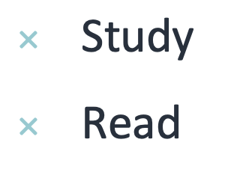
organize
What tasks need to be done?
How can you improve your learning?
Do you need to…
  Practice skills
  Mind map

Slide 20
set priorities
What is due first?
What is your timeline?
What is most difficult?
What will take the most time?
Will you need to ask for help?

Slide 21
make a plan
What will you work on first?
What materials / resources do you need?
Book your PLT space / teacher!
Write your PLT goal!

