Slide 1
December 2024 Parent-Teacher Conferences
Instructions

Slide 2
Details
Conference slots are 5 minutes
Parents should only book with a teacher for 1 time slot. If more time is needed, please connect with the teacher to schedule.
Parents will receive an email confirmation after booking appointment.
Reminder emails will be sent 1 day prior to the appointment.
Bookings will be unavailable after 4:00pm the day prior to the conference day.

Slide 3
December Conferences
Conferences on December 10 are available from
2-4pm & 5-7pm
Conferences on December 11 are available from
2-4pm

Slide 4
How to book an appointment
Visit: Richmond https://outlook.office365.com/owa/calendar/RSSParentTeacherConferences@sd38.bc.ca/bookings/

Slide 5
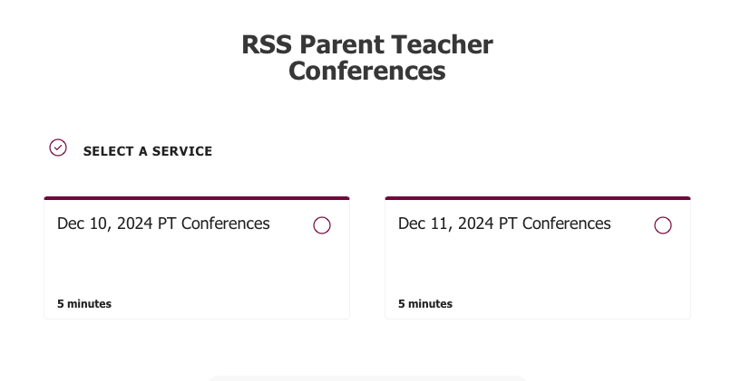
How to book an appointment
2) Select an Appointment Day
Click for more details
Click for more details

Slide 6
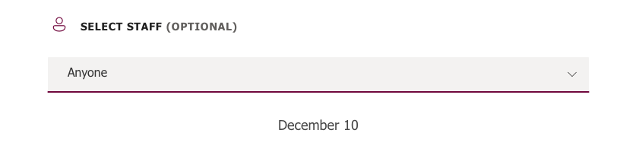
How to book an appointment
3) Select a Teacher
NOT OPTIONAL
Use this drop-down to select the teacher.

Slide 7
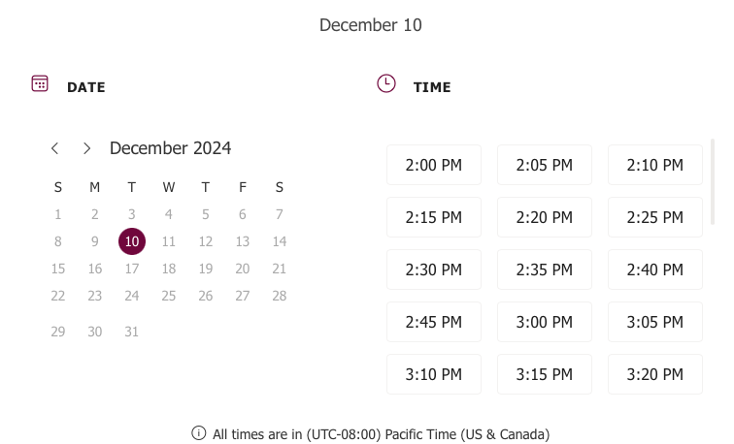
How to book an appointment
4) Select an available time slot
Only times that are available will appear here.
Select 1 time slot.

Slide 8
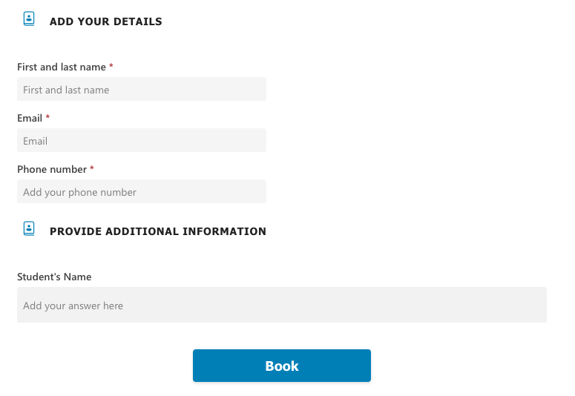
How to book an appointment
5) Enter your contact information
Parent Contact Information
Enter your student’s Usual Name
CLICK BOOK TO SUBMIT

Slide 9
Booking Confirmation
After booking your appointment, you will receive a confirmation email with the details shown here.
If you need to reschedule an appointment, please use the ‘reschedule’ button at the bottom of the email.
  You will not be permitted to reschedule an appointment within 24 hours of the start of appointments.

Slide 10
Support
Please refer to this guide for support.
If you have any questions or concerns, please contact Richmond Secondary School at richmond@sd38.bc.ca
or 604-668-6400.

